Slide 1

Object Oriented and Functional Programming with Python (Habit Tracker)
Created by:Fahri Efe Yaniklar

Slide 2

Introduction
This application must be a good application for those who want to be planned and methodical. In this application, everything must be easily accessible, user-friendly, and not complicated. Application designed and created for this. This presentation explains the technical background and development stages.

Slide 3
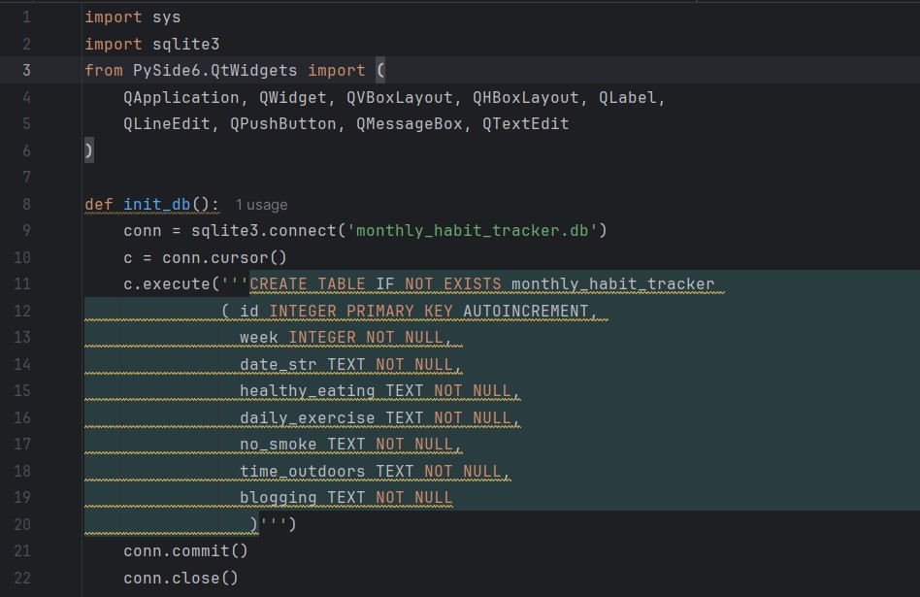
1.Import Process and Defining Functions
In this section firstly we have to import tools for our application and we need to create table for user can fill it. In import section we need to import sys(for python interact with system), sqlite3(for create and type query) and PySide6.Qtwidgets (for GUI (Graphical User Interface)). In the def_init function, we are creating a table with sqlite3 for users can fill in his/her information.

Slide 4
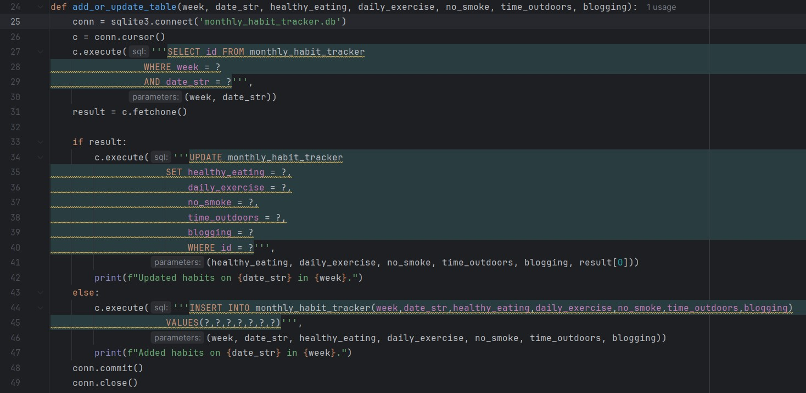
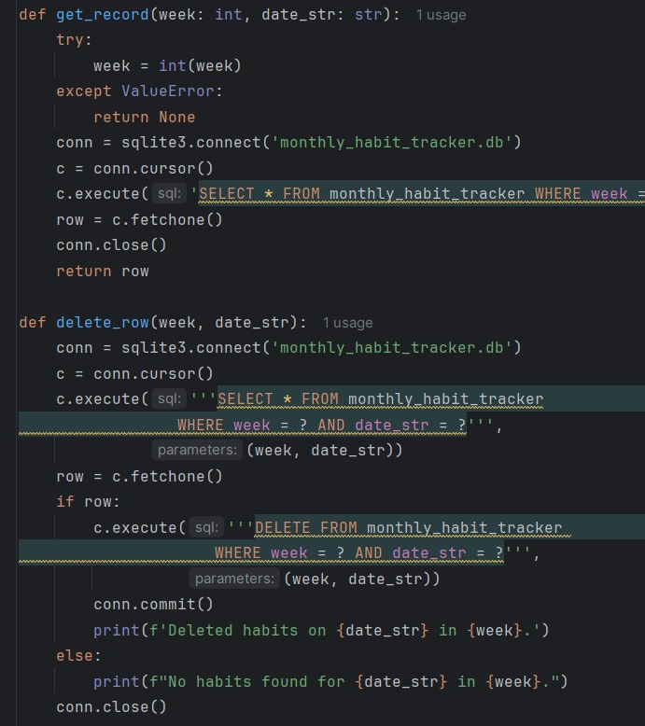
Next, defined the add_or_update_table function this function is used for adding a row or updating a row in the table. Then defined get_record and delete_row functions, get_record is used for see which you want to record, and delete_row function is used for deleting which you want row.

Slide 5
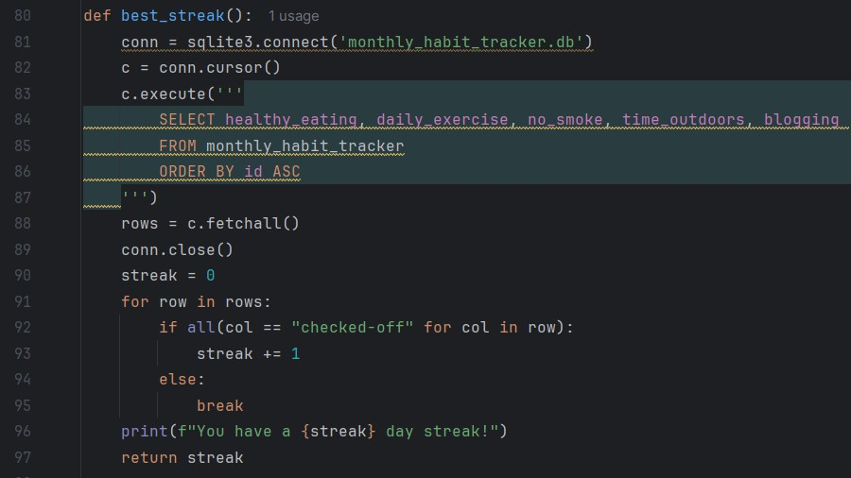
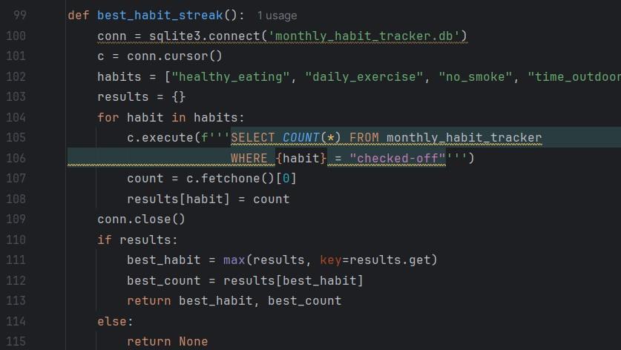
Next, defined best_streak and best_habit_streak. In this section, best_streak is used to see the perfect days (every habit checked-off), and best_habit_streak is used to see the most checked-off habit.

Slide 6
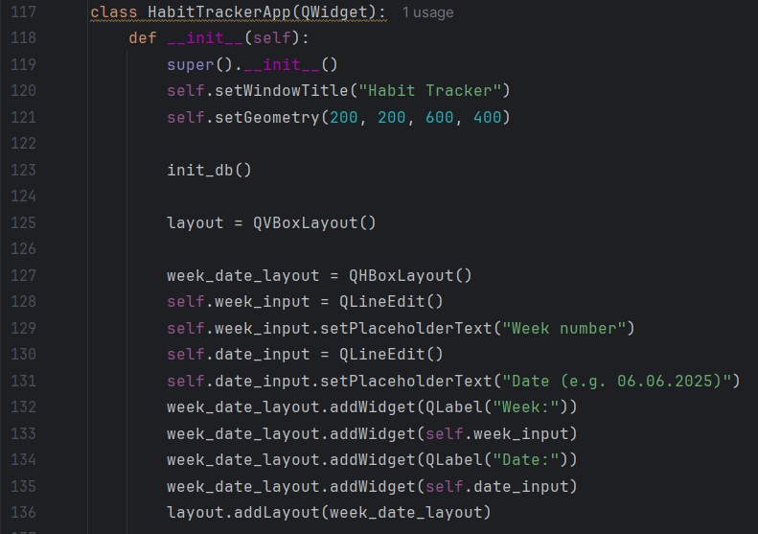
2.Creating GUI (Graphical User Interface)
In this section, we defined a class for GUI (Graphical User Interface). Firstly, created a GUI tab and week and date input space.

Slide 7
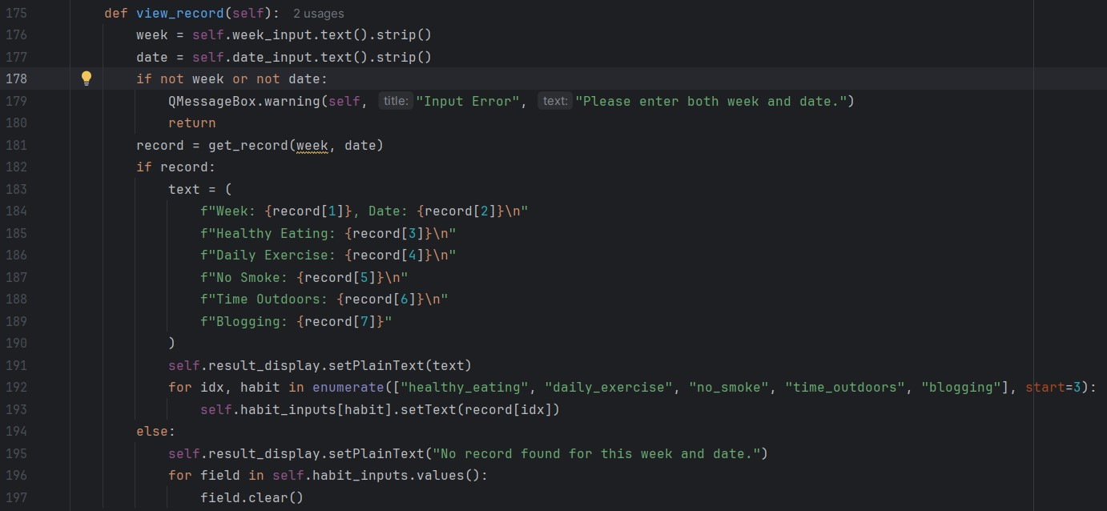
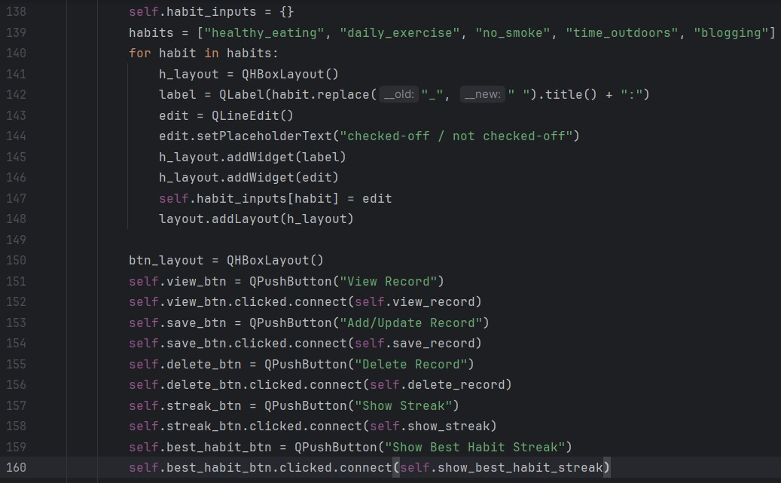
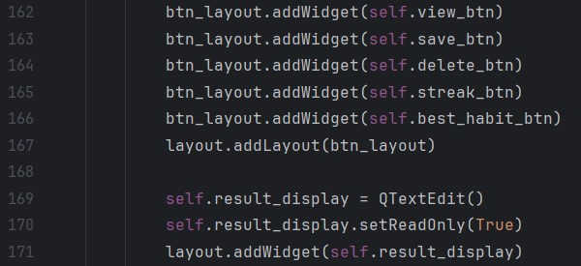
Next, we created the main form and buttons for interacting with the database and GUI. As you can see created ‘View Record’ button’s a technical background.

Slide 8
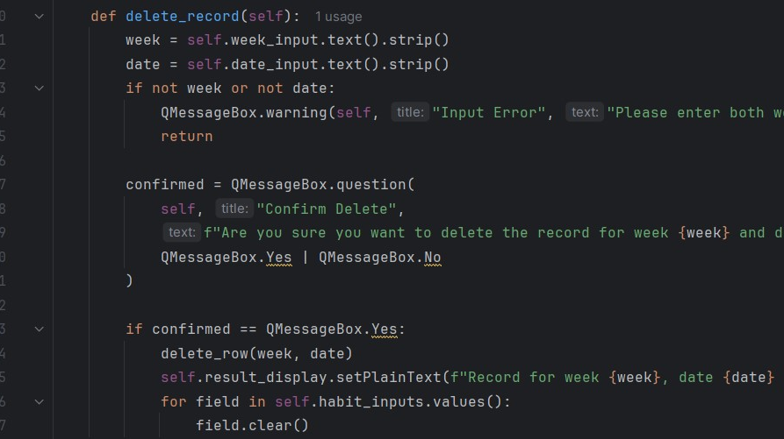
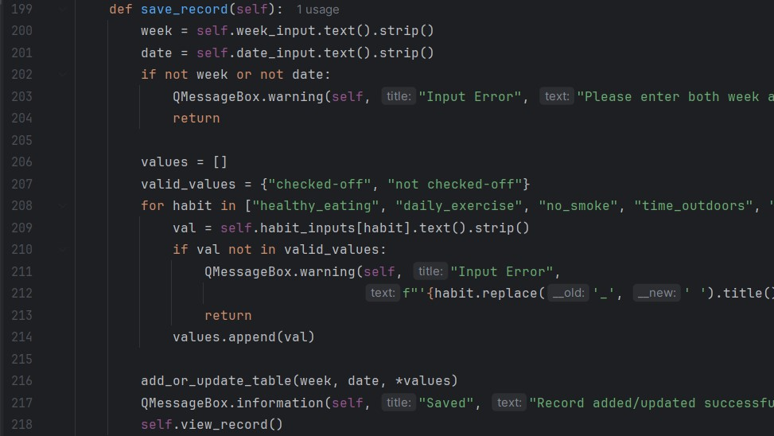
Then, built the ‘Add/Update Record’ and ‘Delete Record’ technical background.

Slide 9
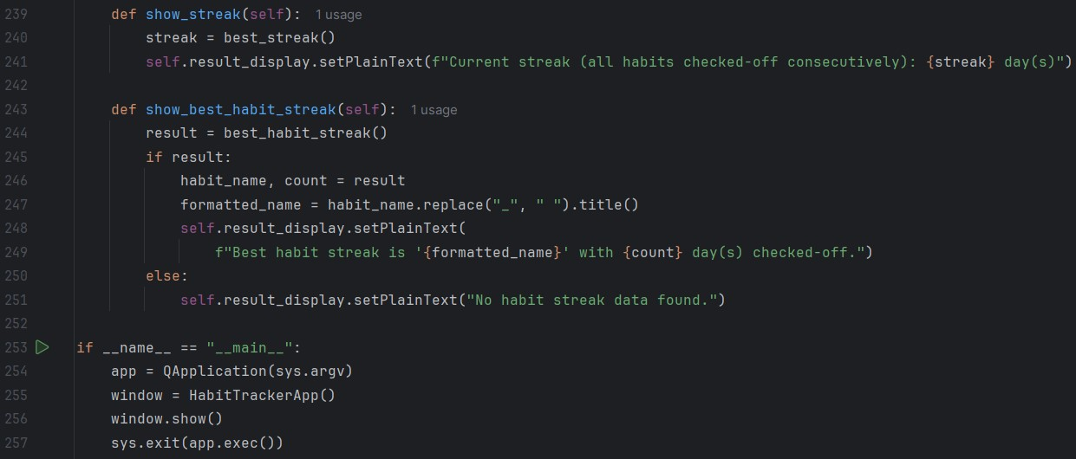
Finally, ‘Show Streak’, ‘Show Best Habit Streak’ technical infrastructure was created to ensure that the system opens and closes properly.

Slide 10
Thanks for reading my presentation.
Created by: Fahri Efe Yaniklar

